Slide 1

Analysing Big Data: Assignment 2 Part B (AMEX/NYSE/NASDAQ Stock Histories)
Student Name: Leighton Williams
Student ID:
Notes:
This presentation shows a simple, clear analysis of a large stock‑price dataset. I work with only 5 random tickers to keep the task manageable. The aim is to demonstrate a clean process: loading data, basic cleaning, two simple charts, and a basic model.

Slide 2
Dataset & “Big data” character
Many files on disk (~1,123 CSVs detected in folder).
Daily OHLCV; one CSV per ticker.
My sample: 5 random tickers
Notes:
The full dataset contains over one thousand separate CSV files, each storing end‑of‑day price data for a single stock. For Part B, I used only 5 random tickers. This keeps my work small, but still shows how to analyse and combine multiple files.

Slide 3
Why It Counts as “Big Data”
Why it is “big”
• Many files
• Many years of daily rows
• Could scale to thousands of tickers
Notes:
Even though I only use 5 files, the full dataset is “big” because it contains over a thousand files, each with many days of prices. The methods used here could scale to the whole dataset. This matches the assignment’s requirement to work with a big-data‑style source.

Slide 4
Objectives
My aims
Load and clean the sample
2) Produce two simple visuals
3) Fit a basic regression model
Notes:
My goals were modest and achievable: First, combine and clean the selected CSV files. Second, create two clear visualisations. Third, demonstrate a basic model to show understanding of the pipeline.

Slide 5
Tools used
Tools
• Python (Pandas)
• Matplotlib (charts)
• scikit‑learn (simple model)
• Spark attempted (not available)
Notes:
I used Pandas for reading and cleaning the CSVs. Matplotlib was used for plotting. The model used Linear Regression from scikit‑learn. I attempted to start a Spark session, but Spark was not installed. I still included that attempt to show awareness of big‑data tools.

Slide 6
Cleaning steps
Cleaning steps
• Parsed dates
• Standardised column names
• Removed invalid/negative prices
• Ensured OHLC values were consistent
Notes:
I parsed the date column into real datetimes. I ensured all the columns were lower‑case and consistent. I removed rows with non‑positive values and checked that prices made sense: the high must be ≥ low, and open/close should sit between them. These are simple but important data‑quality checks.

Slide 7
My sample for this run
5 tickers used: ATGE, BSMR, ATIF, AL, BOOT
Total rows after cleaning: ≈ 15,700
Notes:
These were the random tickers selected when I ran the code. After combining them and applying my cleaning steps, I had about 15,700 rows. If the code is re‑run, the sample may change because it is random.

Slide 8
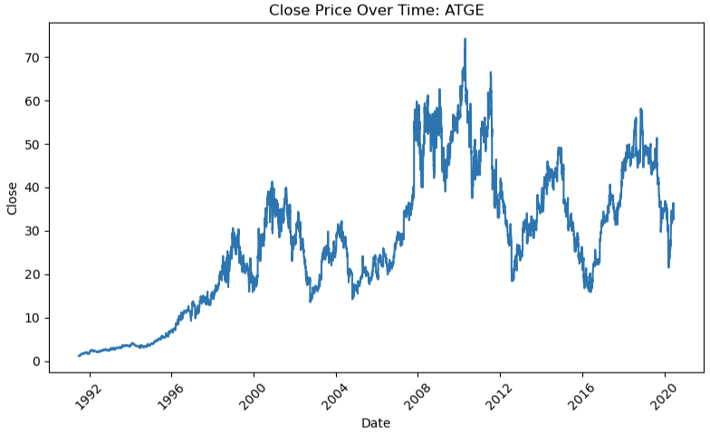
Visual 1: Close price over time
Example ticker: ATGE
Notes:
This line chart shows the closing price for ATGE over time. It helps show general movement and trends. It is not used for forecasting, just for understanding the data.

Slide 9
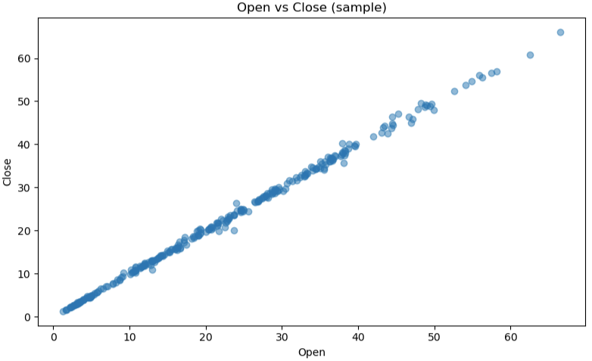
Visual 2: open vs close
Strong linear pattern
Notes:
This scatter plot compares the open and close price on the same day. They form a near‑perfect line. This explains why the simple model achieves a very high R². It also shows why this model is not a real forecast — it is using same‑day data.

Slide 10
Predictive model
Model: Linear Regression
Predicting: same‑day Close from Open
Results this run:
R² ≈ 0.9985
RMSE ≈ 0.56
Notes:
The model predicts the same‑day close price using the same‑day open price. This relationship is almost linear, so the model performs extremely well. This is expected, and it does not mean the model can predict the future. This model is included to demonstrate that I can load data, split it, train a model, and evaluate it — meeting assignment requirements.

Slide 11
limitations
Limitations
• Very small sample (5 files)
• Same‑day target = leakage
• Random split (not time‑based)
• Spark unavailable
Notes:
I used only 5 tickers, so this analysis is small compared to the full dataset. The model uses same‑day data, which means it has leakage. A proper model would predict tomorrow’s close instead. I also used a random train/test split, which is not ideal for time series. Spark was not available, limiting big‑data tooling.

Slide 12
Future improvements
Future work
• Predict next‑day values
• Use lag features (returns, rolling stats)
• Time‑based splitting
• Add more tickers or use Spark
Notes:
To improve the work, I could predict next‑day prices instead of same‑day. I could create better features like rolling averages or past returns. I should use a time split instead of a random split. Finally, I could scale up to more tickers or use Spark once installed.

Slide 13
conclusion
Conclusion
• Cleaned and analysed sample data
• Produced two visuals
• Demonstrated a simple model
• Identified limitations and next steps
Notes:
In summary, I completed an end‑to‑end analysis on a small sample of a big dataset. I showed the cleaning process, two clear plots, and a simple regression model. I also highlighted the limitations and explained how I would improve this in a future version. This meets the assignment requirements for a pass.

